Slide 1
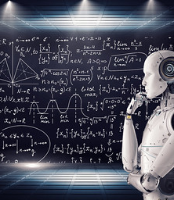
Deep Learning with Python Transfer Learning
Edgar Lobaton, Ph.D.
Electrical & Computer Engr. Dept.
North Carolina State University

Slide 2
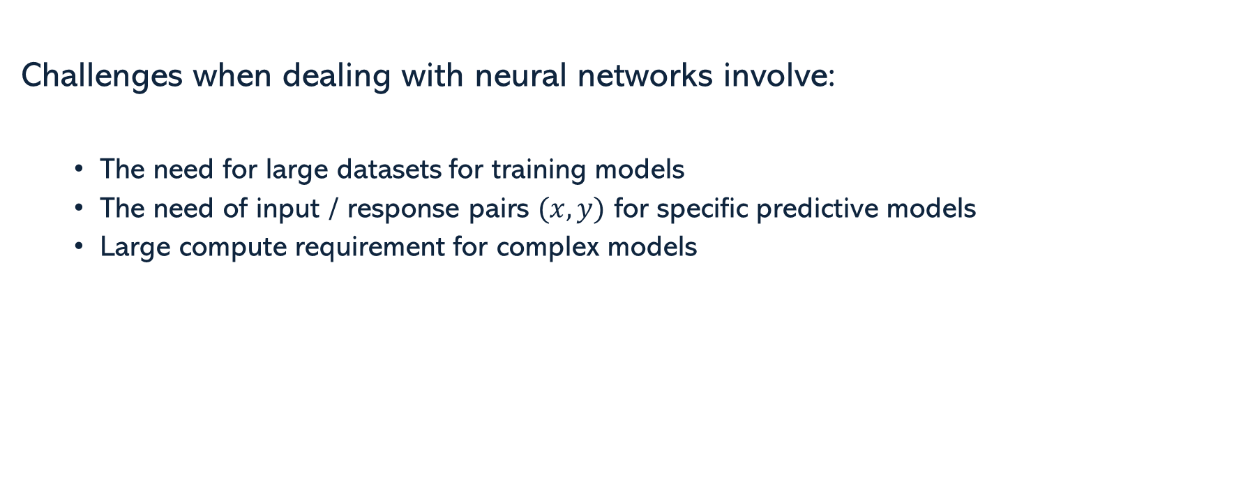
Challenges
Challenges when dealing with neural networks involve:
The need for large datasets for training models
The need of input / response pairs $(x,y)$ for specific predictive models
Large compute requirement for complex models

Slide 3
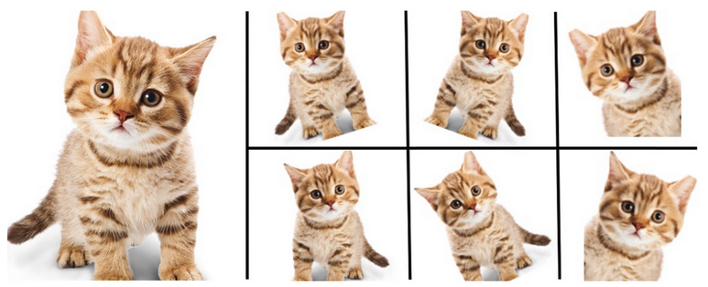
Data Augmentation
There are many way to artificially increment the amount of data that we have for training. For example, via by adding noise to real data, transforming the real data, adding synthetic context to real data, or creating synthetic data.

Slide 4
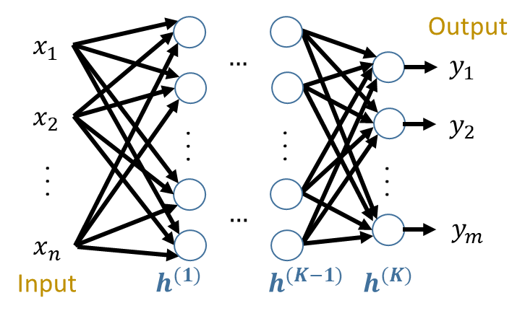
Transfer Learning & Multi-Task Learning
Parameter Transfer across Datasets
Multi-Task Learning
Semi-Supervised Learning Variations
Task 1
Input
Task 2
Input

Slide 5
Knowledge Distillation
Looks for ways to transfer “knowledge” from large models to smaller models that are easier to deploy
Often the knowledge is transferred by:
Comparing responses
Comparing feature values
Comparing feature relationships
This is very useful for deployment on embedded devices

Slide 6




Thank you
Edgar Lobaton
edgar.lobaton@ncsu.edu
https://research.ece.ncsu.edu/aros/

